Slide 1
The Reporting of Concussion in Sport
Daniel Owen
13324486
Computer Science & Business
Date 04/04/2017
Notes:
Intro – My project is on the reporting of concussion in sport with a specific focus on rugby in this case.
I am a final year computer science and business student and with the help of Mary and a number of others I have brought this project from the idea generation phase to where it is today.

Slide 2
Overview
Background
Design
Implementation
Demo
Issues
Evaluation
Conclusions
Notes:
Overview – These are the topics I will be going through. These topics cover a majority of what the project involves.
Background: I will talk about why I picked this project and what exactly it means to me.
D&I: Im going to talk about the software and technologies I used and also the development model I chose.
Demo: All going to plan I will walk you through my website, we will create a user account and add a concussion into database.
Issues: This one is pretty self explanatory. I had a couple of issues regarding the hosting of my website and my scheduling of time also.
Evaluation: I will critique my meeting of requirements. Also in this part I will talk about my plans for the website for the future and especially in the coming months after exams.
Conclusion: To conclude I will quickly go through what exactly I have learned from this project and a reflection of my own work.

Slide 3
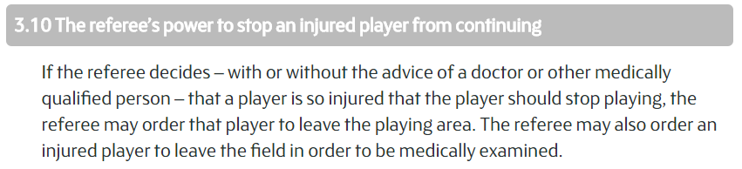
Background
Why? What reasoning did I have for doing a project on concussion in rugby?
Suspected concussions are dealt with differently at both a domestic and professional level.
Professional: HIA
Domestic: Law 3.10
Notes:
Background – Ive played rugby since I was 6/7 in my local club, Enniscorthy. I’ve played at each each grade the whole way up and Ive also played at each grade of senior rugby within the club. Like everyone who has played rugby I’ve had a number of injuries ranging from sprains and scrawbs to dislocations and breaks.
Along with these I’ve unfortunately had a number of concussions which really do affect your ability to partake in normal life. Because of this, its something I wanted to look into further and to learn more about.
At both professional and domestic levels, concussions are dealt with differently:
HIA at professional
Law 3.10 to force player from pitch at domestic level

Slide 4









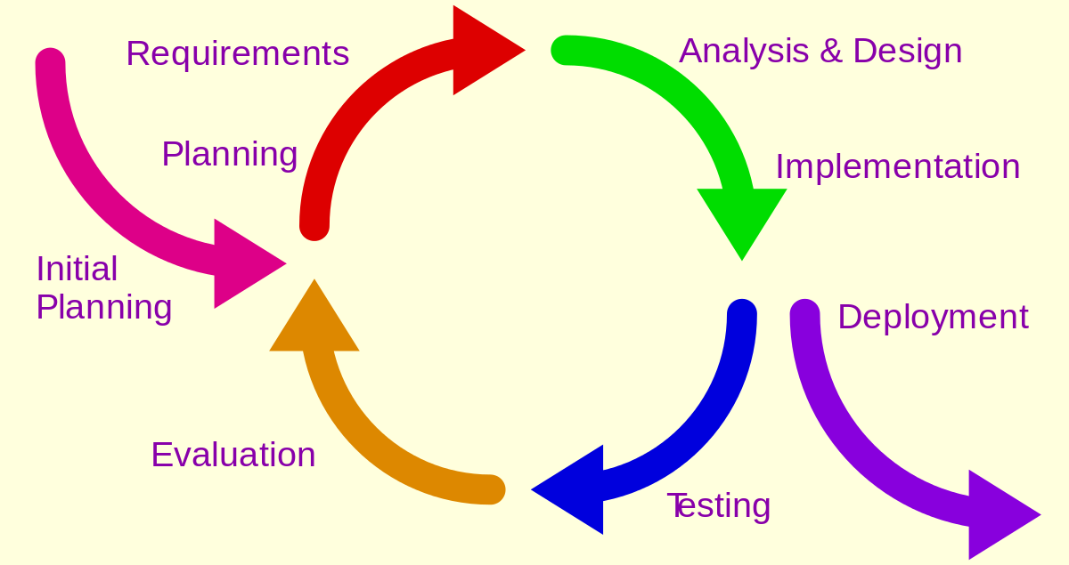
Design & Implementation
Software & Technologies
Iterative & Incremental Development Model
Notes:
Design & Implementation: I’m sure you both know most of these. Throughout my project I’ve used them at one stage or another. Some I’ve used to just test the connections to make sure my PHP was alright like MAMP which sets up a local server environment and from that I used 000webhost which allowed me to set up the MySQL database. phpMyAdmin made this aspect far simpler. It allowed me to build my database with a cleaner UI than using the command prompt and a script.
HTML, CSS, JavaScript and PHP were what I used to build my website. PHP interacted with my database while HTML and CSS gave me the client side and JavaScript added interactiveness.
I feel an iterative-incremental hybrid suited my project best. It allowed me to have a basic working model early on in the development stages and then add functionality with each iteration.
Once the major requirements were defined. I was able to work within them using the model to keep me on track.

Slide 5
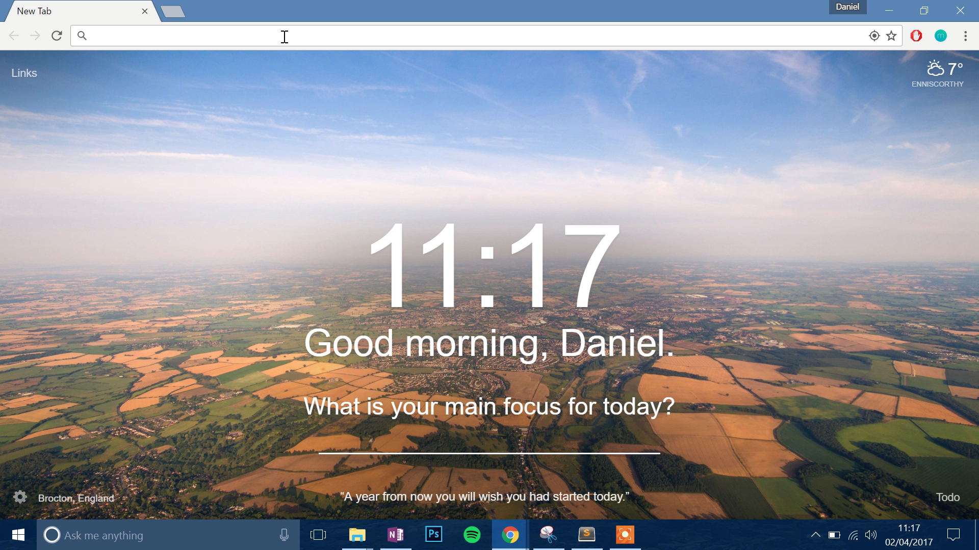
Demo
http://concussionlog.net16.net/

Slide 6
Issues
Hosting Issues:
PHP Version 5.2: Finding a way to get the difference between two dates.
000webhost.com: Sometimes took a while to update HTML/CSS.
Inspecting the code in browser was very useful.
Keeping on top of FYP while other deadlines were approaching.
Notes:
Issues: Thankfully, I didn’t run into many problems throughout my project. My main issues were with my hosting server, 000webhost.com. One of these was the PHP version they run on their servers. The latest version of php available is 7.1.3 whereas the 000webhost servers run version 5.2 which has been out of date since 2009. This added a lot of extra work to find the difference between two dates given in the eligibility function. Thankfully, I resolved this issue but not without far too long spent searching through stackoverflow and php documentation.
Once I uploaded my latest version of css to the server I sometimes found that it took a number of hours/days for my site to fully update which I thought was strange. Currently I have no answer to this issue but its probably down to the fact that im using a free hosting solution.
I had an issue with scheduling but this was down to my own time management. I found it difficult to sit down to do a bit of coding when other assignments for other modules were due. This was seen especially after Christmas where my other modules really took over leaving FYP left behind.

Slide 7

Evaluation
Successful implementation of all that was set out in the gathering of functional requirements.
Non-functional requirements were met:
Robustness
Performance
Reliability
Usability
Future Work:
Further development to aid research.
Get in touch with IRFU or a provincial branch.
Add a statistical element.
Notes:
Evaluation: I was extremely happy that I was able to meet all of the functional requirements which I set out in the beginning. These were to: have fully functional database, a log in system, a means to input data, have a function to show the eligibility of a player and a search function.
As far as NF requirements go, I was happy also. I broke my NF requirements down into 4 different groups, Usability, robustness, performance and reliability. In terms of performance, reliability and robustness I think my website goes a long way to fulfilling these needs. It is also quite an easy website to use as you have seen but I believe this is down to each individual user.
Future Work: From all the research I conducted and journal articles I read, it seems as though most of the information about concussions comes from players. I would like to possibly partner up with a researcher who is willing to gather data from referees with the use of my website. With this, I would need to add a statistical element to the dashboard where the researcher can query the database and receive the necessary data such as which position is most prone to receiving concussions or is there certain times of the year where the occurrence of concussions rise.

Slide 8
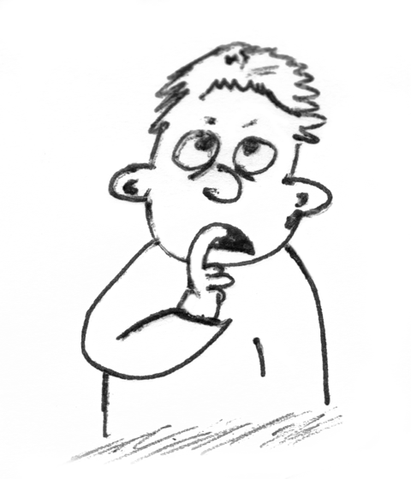
Conclusion
Learnings:
Impact of concussion on the brain.
Chronic Trauma Encephalopathy (CTE)
Underreporting of a head injury in matches.
Reflection
Notes:
Conclusion: I’ve learned a huge amount about the effects of concussion on the brain. Even subconcussive blows can have lasting effects which can lead to degenerative diseases. Recently, as portrayed in the movie ‘Concussion’, Dr Bennet Omalu diagnosed a number of retired American footballers with CTE, a disease similar to alzheimers. This disease is seen in those who have received repeated blows to the head. Unfortunately it is only possible to diagnose it after one’s death and therefore it is impossible to see the true extent of the disease in American Football, rugby or in football where even heading a ball can lead to concussive blows which in turn can lead to degenerative brain diseases like in the case of Jeff Astle who played in an age where they used a heavy leather ball.
This is the first time I have designed and built a working system on my own. Thankfully the course gives me the necessary tools such as learning about databases in information management, the different development lifecycle models in a number of modules and of course the exposure to a huge range of programming and markup languages throughout.
Above all else I just wanted to highlight the devastating effects that concussions can have on the brain.

Slide 9
Questions?

Slide 10
Thank You!

